Slide 1
Using the Loader
Michael McLennan
HUBzero® Platform for Scientific Collaboration
Purdue University
This work licensed under
Creative Commons
See license online:
by-nc-sa/3.0

Slide 2
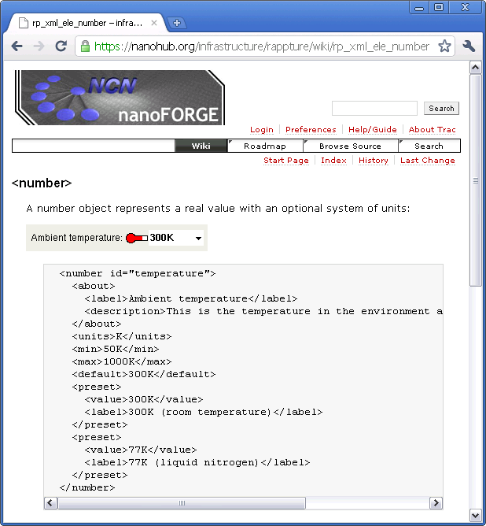
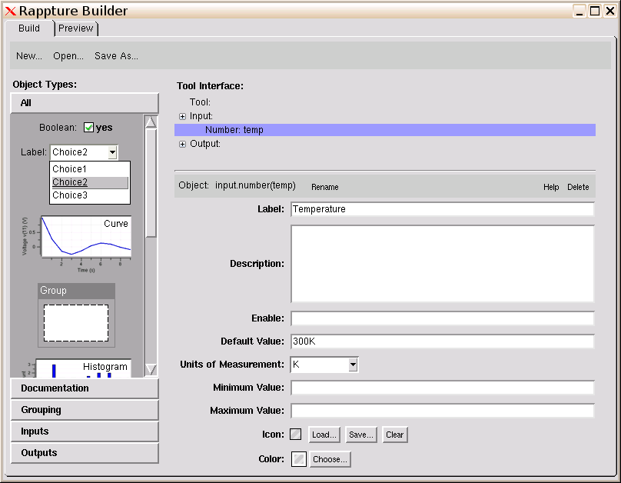
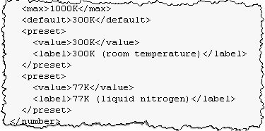
Under the hood: XML
The builder is great, but it’s not perfect
Where are the
preset controls?

Slide 3

Under the hood: XML
Builder
<?xml version="1.0"?>
<run>
<tool>
<title>Example with temperature</title>
</tool>
<input>
<number id="temp">
<about>
<label>Temperature</label>
</about>
<default>300K</default>
<units>K</units>
</number>
</input>
</run>
<preset>
<value>300K</value>
<label>300K (room temperature)</label>
</preset>
<preset>
<value>77K</value>
<label>77K (liquid nitrogen)</label>
</preset>
</number>
</input>
</run>
<XML>
skeleton
program
tool.xml
You can add stuff
like this by hand

Slide 4
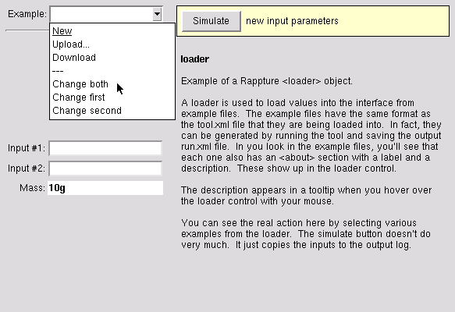




Introducing the loader…
loader
Change both
Change first
Change second
New

Slide 5
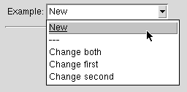

Loader definition
Put the loader definition in your input section, usually near the top:
<loader>
<about>
<label>Example</label>
<description>This loads examples.</description>
</about>
<new>new.xml</new>
<example>*.xml</example>
<default>new.xml</default>
</loader>
These files sit in
@tool/examples
@tool is where tool.xml sits
Load by default
tool.xml
examples
first.xml
second.xml
both.xml
new.xml

Slide 6
Creating example files
How do you make an example file?
cp tool.xml examples/both.xml
vi examples/both.xml
<?xml version="1.0"?>
<run>
<about>
<label>Change both</label>
<description>This example changes both inputs, #1 to "first" and #2 to "second"</description>
</about>
…
<input>
<string id="one">
<current>first</current>
</string>
<string id="two">
<current>second</current>
</string>
</input>
</run>
Add a description
for the example
Set a <current>
value for each
element you want
to set

Slide 7
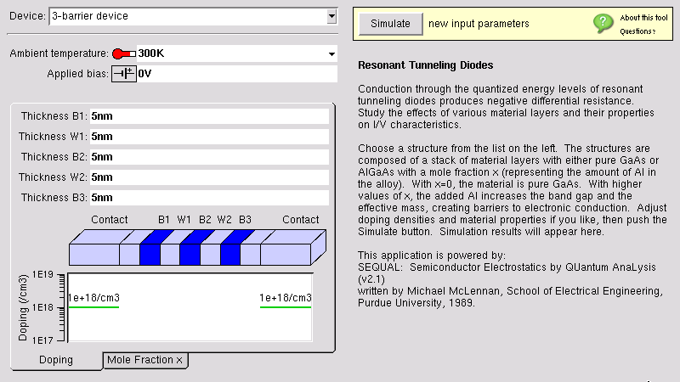
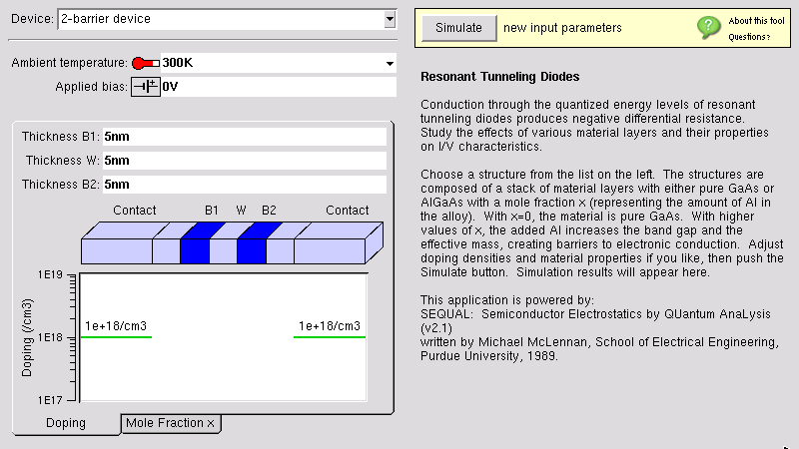
More complex example
loader
leaves these alone
loads a <structure> element
https://nanohub.org/tools/rtd

Slide 8
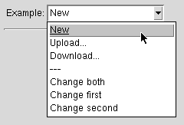
Using the loader to upload/download data
Add targets for upload/download forms
<loader>
<about>
<label>Example</label>
<description>This loads examples.</description>
</about>
<upload>
<to>input.string(indeck)</to>
<to>input.string(datafile)</to>
</upload>
<download>
<from>input.string(indeck)</from>
<from>input.string(datafile)</from>
</download>
<new>new.xml</new>
<example>*.xml</example>
<default>new.xml</default>
</loader>
Prompts the user to
upload directly into
various controls
Most useful for
<string> inputs
Allows the user to
download input values,
edit, and upload again

